Slide 1

SayCan-Extended: Optimizing For Practical Robotic Control
CSCE585-001-FA2024
Joshua Moorehead
Senior from Pittsburgh, PA
B.S.E. in Computer Engineering

Slide 2

Problem
Challenge:
Bridging natural language instructions into feasible robotic actions in an environment
Why it matters:
Making robots more accessible and capable
Notes:
SayCan is a framework that helps robots understand and act on human instructions by combining language understanding with physical capabilities. Think of it as a translator between what humans say they want and what robots can actually do. The name 'SayCan' comes from this idea - converting what humans 'say' into what robots 'can' do.
Often LLM lack contextual grounding for solving complex tasks.
For example instructing someone on how to clean up a spill could result in ambiguous or even impossible solutions given the environment.
Interesting: Bridge together NLP, RL, and robotics. Combining LLM with physical robot. Human-robot interaction
Service robots.

Slide 3
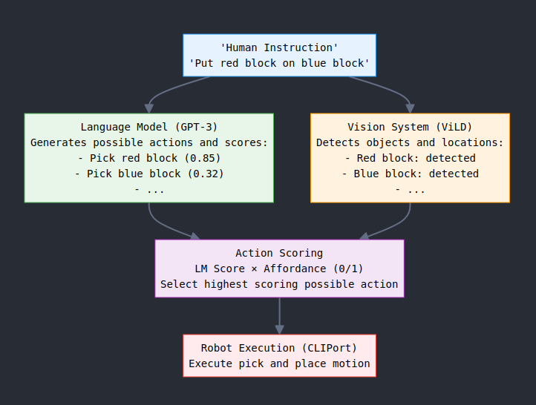
How it works
Notes:
Let me walk you through how SayCan works. Starting at the top, we have a human instruction like 'Put red block on blue block'. This instruction flows into two parallel processes:
On the left side, our Language Model (GPT-3) analyzes the instruction and breaks it down into possible actions we might want to take. For example, picking up the red block would be a good first step.
Meanwhile, on the right side, our Vision System (ViLD) is looking at the scene and identifying what objects are present and where they are located. It needs to find both the red and blue blocks.
These come together in the Action Scoring phase, where we combine:
How much the language model thinks each action helps achieve our goal
Whether that action is actually possible based on what objects we can see
Finally, once we've selected the best action, CLIPort executes the physical movement with the robot.
After updating the state, the cycle continues until the task is complete.

Slide 4
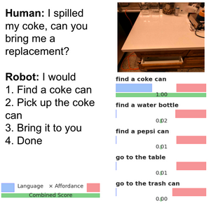
Core Components & Scoring
Components
Scoring
Language Model (GPT-3)
Breaks down high-level instruction
Vision System (ViLD)
Detects objects in scene
Understands spatial relationships
Robot Control (CLIPort)
Executes pick and place actions
Provides feedback
Notes:
"ViLD is like the robot's eyes - it looks at a scene and can identify objects by name. It does this by learning from millions of image-caption pairs (like photos with descriptions). When we say 'find a red block', ViLD looks at the camera image and draws boxes around what it thinks are red blocks, giving each a confidence score based on how sure it is.
CLIPort is like the robot's brain-to-hands connection. When given a command like 'pick up the red block', it looks at the camera image and figures out exactly where to move the robot's gripper to pick up and place objects. It learned this by watching humans demonstrate thousands of successful pick and place actions."
CLIP is a model by OpenAI that matches descriptions to pictures like a dog pic
LLM Scoring: For each possible action, GPT-3 is prompted with: "{query}{option}\nHow likely is this to succeed on a scale of 0-10?"
And then normalized to 0-1. 53 actions in open source version.
Open source affordance scoring: checks if the objects exist in the PyBullet environment using ViLD. If they do, it is assigned a 1.
Actual paper: learned value functions using RL policies. Such as “is picking up this object with my current camera angle + object position feasible?” and object tendencies such as “picking up this object on its sides works more than picking it up at its center” with thousands of demos
The system scores each possible action in two ways:
Language score (0-1): How well the action helps achieve the goal
Affordance score (0/1): Whether the action is physically possible
Final Score = LM Score × Affordance Score

Slide 5
Initial Experiment
Setup Phase
Retrieved og SayCan open source implementation
Fixed all old dependency issues
Environmental setup hurdles
OpenAI API integration
PyBullet config
GPU - CUDA setup on my machine
Python package conflicts
Updates
GPT-3 davinci → GPT-3.5-turbo-instruct
Compatible newer PyTorch and JAX versions
CLIP model memory management
Type handling for JAX/NumPy arrays
Better checkpoint handling/saving during saving
Error handling
Notes:
Demo.

Slide 6
Initial Experiment P2
Adding Measurement setup
Performance monitoring on API call latency, token usage, task failure/success rate, etc
Task execution monitoring
Plan generation success rate, execution rate, correlation
Testing it
Tasks:
Single block movements
Color Matching tasks
Multi-step sequences
Performance metrics tracking
Rates
Usage
Latency
Notes:
Demo.

Slide 7
Major Issue!
CLIPort Behavior
Solution
Weights would not load correctly
Neural network predictions for pick/place targets were off
Trained on demonstration data that was not public
Direct PyBullet object tracking
Hardcoded coordinate-based control
Direct Pick and Place executions
However… Many hours spent trying retrain CLIPort from repo found online (more dependency issues) & running it on old JAX and Torch but on a CPU (too reliant on GPU acceleration)
Resulted in….
0% action success rate
Unreliable coordinate projections
SayCan to repeat itself
Notes:
"ViLD is like the robot's eyes - it looks at a scene and can identify objects by name. It does this by learning from millions of image-caption pairs (like photos with descriptions). When we say 'find a red block', ViLD looks at the camera image and draws boxes around what it thinks are red blocks, giving each a confidence score based on how sure it is.
CLIPort is like the robot's brain-to-hands connection. When given a command like 'pick up the red block', it looks at the camera image and figures out exactly where to move the robot's gripper to pick up and place objects. It learned this by watching humans demonstrate thousands of successful pick and place actions."
CLIP is a model by OpenAI that matches descriptions to pictures like a dog pic
LLM Scoring: For each possible action, GPT-3 is prompted with: "{query}{option}\nHow likely is this to succeed on a scale of 0-10?"
And then normalized to 0-1. 53 actions in open source version.
Open source affordance scoring: checks if the objects exist in the PyBullet environment using ViLD. If they do, it is assigned a 1.
Actual paper: learned value functions using RL policies. Such as “is picking up this object with my current camera angle + object position feasible?” and object tendencies such as “picking up this object on its sides works more than picking it up at its center” with thousands of demos
The system scores each possible action in two ways:
Language score (0-1): How well the action helps achieve the goal
Affordance score (0/1): Whether the action is physically possible
Final Score = LM Score × Affordance Score

Slide 8
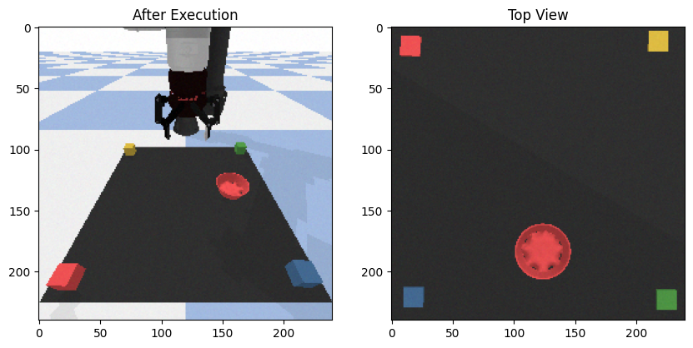
Exp 1: SayCan VS. Socratic
Initial Performance:
SayCan Results:
success_rate: 0.000
avg_steps: 0.000
avg_time: 48.736
Socratic Results:
success_rate: 0.250
avg_steps: 0.500
avg_time: 24.098
TASK EXECUTION SUMMARY Task: put blocks in their matching colored bowls
Executed Steps:
1. Pick the blue block and place it on the blue bowl.
2. Pick the blue block and place it on the green block.
3. Pick the red block and place it on the middle.
4. Pick the blue block and place it on the red block.
5. Pick the blue block and place it on the red bowl.
Task completed. Success: True (???)
Notes:
Demo.

Slide 9
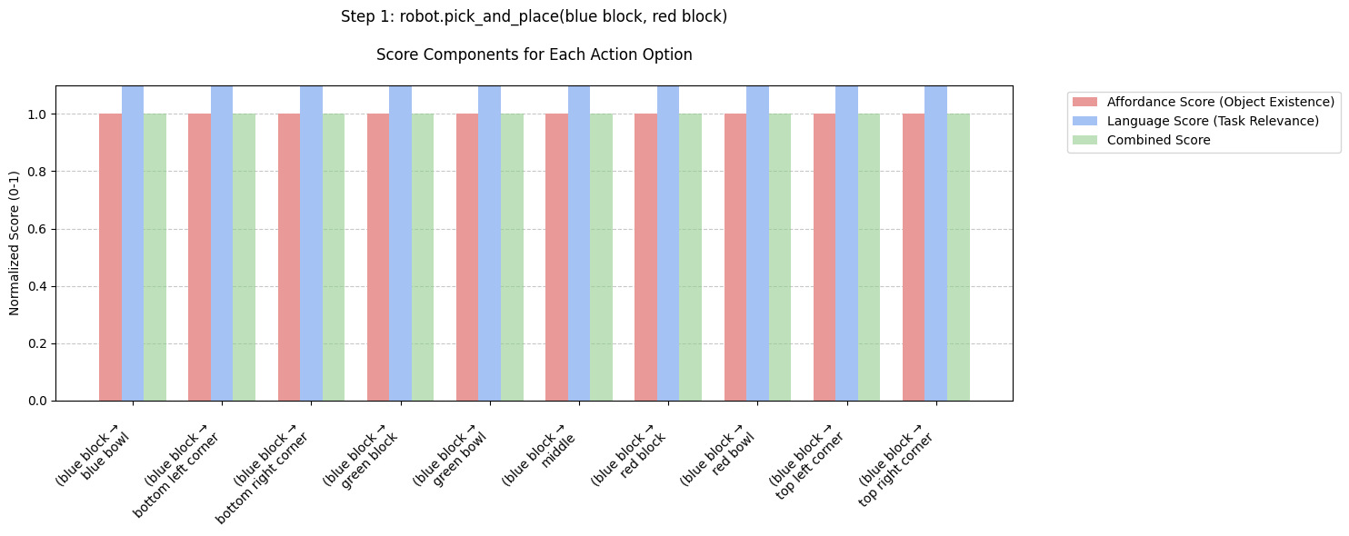
Issues
.
Notes:
Affordance score is too basic. 0-1 if an object is detected. Almost pointless for the selected actions from GPT3 only contain objects in the environment. All actions have same score from GPT and affordance.

Slide 10
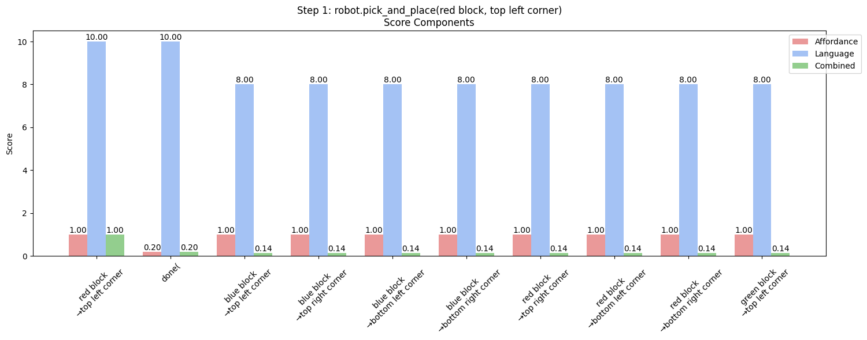
Performance After
For “Put all blocks in different corners”
Notes:
Demo.

Slide 11
Changes with scoring
GPT-3 Scoring:
Task-specific prompts with detailed scoring rubrics (0-10)
Action parsing for pick/place understanding
Increased temperature (0.3) for more varied scoring
Better consideration of task timing and efficiency
Affordance Scoring:
Graduated scoring instead of binary
Physics-aware penalties (accessibility, stability)
Task-specific modifiers (e.g., corner occupation penalties)
Distance-based graduated penalties for spatial relationships
System Improvements:
Better score normalization and combination
Performance monitoring (API usage, success rates)
Improved visualization and logging
More robust error handling
Added state tracking for context awareness
Notes:
Demo.

Slide 12
Pipeline Optimization Experiment
Setup
Performance bottlenecks
Model inference latency (2-3s per GPT-3 call)
Vision system processing overhead
Memory constraints with batch processing
Proposed optimizations
Batch size tuning (1-16 actions)
Response caching for repeated tasks
Concurrent processing where possible
Notes:
Demo.

Slide 13
Pipeline Optimization Experiment
Approach
Expected improvements
Reduced API costs through batching
Lower average latency per action
Better resource utilization
Measurement approach
Throughput (actions/second) vs batch size
Latency profiling across pipeline stages
Cost analysis per configuration
Notes:
Demo.

Slide 14
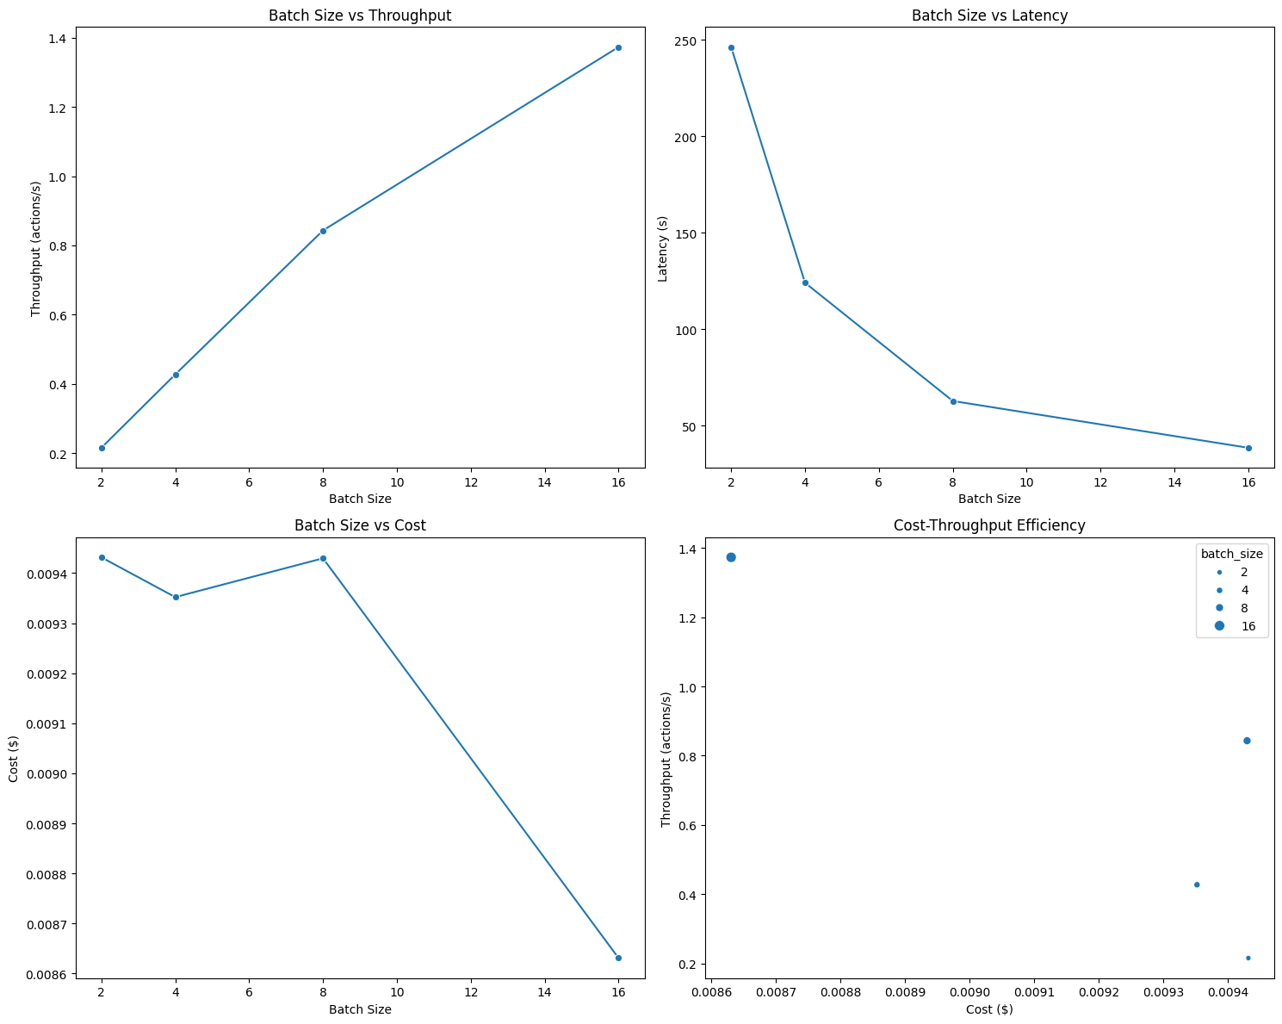
Pipeline Optimization Experiment
Results
Key findings
Optimal batch size: 8-16 actions
Throughput: 1.37 action/s (at bs 16)
Latency: Reduced by 40% at max batch size
Tradeoffs discovered
Memory usage increases with batch size but improves performance
Diminishing returns after batch size 8
Notes:
Demo.

Slide 15
Conclusion
Key Achievements
Implemented SayCan with direct control and better scoring
Improved performanc
On success rate of certain tasks
Reduced latenecy with batch processing
Achieved 1.37 action/s throughput
Reduced API costs during LLM call
Future Work
Improve direct control (possibly get CLIPort working)
Improve grounding ability on more tasks and more complex environment
Sim-Real transfer
Notes:
Demo.

